Slide 1
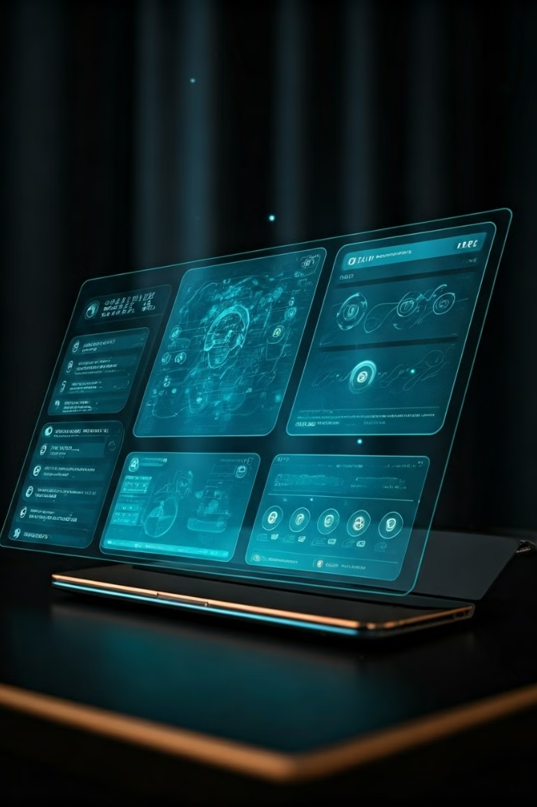
Vizieye: A Multi-modal Personal Assistant
Innovative AI project combining gesture, voice, and object detection for seamless human-machine interaction.
Team Members : Shail Sharma(3837) , Dhruv Kajla(3781)
Navroop(3819) , Mukund(3818)

Slide 2

Problem Statement
Traditional Limitations
Vizieye Solution
Traditional systems face key limitations: voice assistants struggle in noisy environments and with speech impairments, gesture-based interfaces lack precision in complex tasks, and object detection models often struggle with real-time accuracy. These challenges reduce overall system effectiveness and adaptability in real-world scenarios.
Vizieye overcomes these limitations with a multi-modal approach, integrating voice recognition, gesture control, and object detection. This combination enhances accessibility, precision, and adaptability, making it effective across diverse environments and user needs..

Slide 3
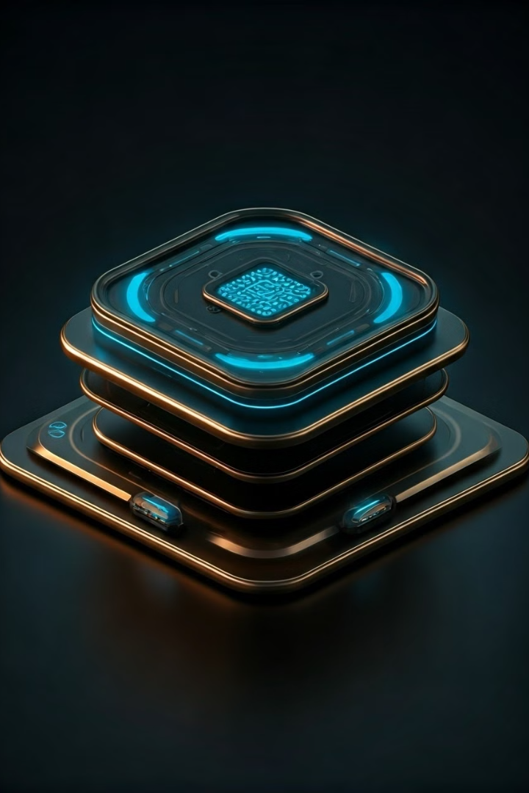



Objective
Develop Multi-modal Assistant
Integrate voice, gesture, and object detection technologies.
Enhance Interaction
Create intuitive human-machine communication through technology fusion.
Improve Accessibility
Cater to diverse user needs and environmental conditions.

Slide 4
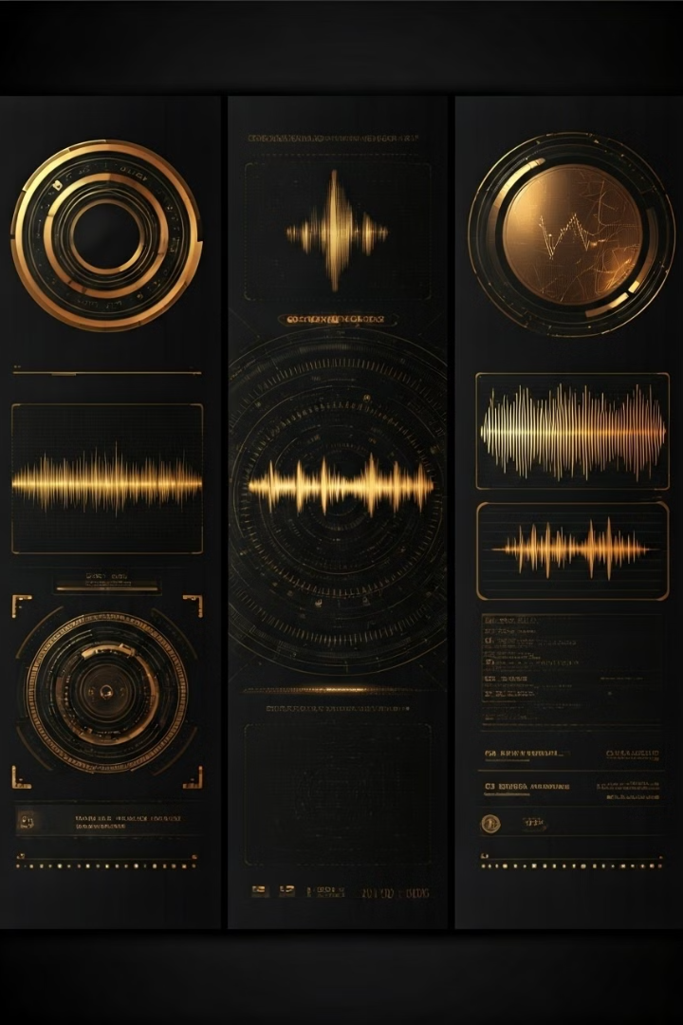


Overview of Two Models
Gesture Recognition
Real-time interpretation of user hand movements and gestures.
Voice Recognition
Processing and responding to various voice commands.

Slide 5
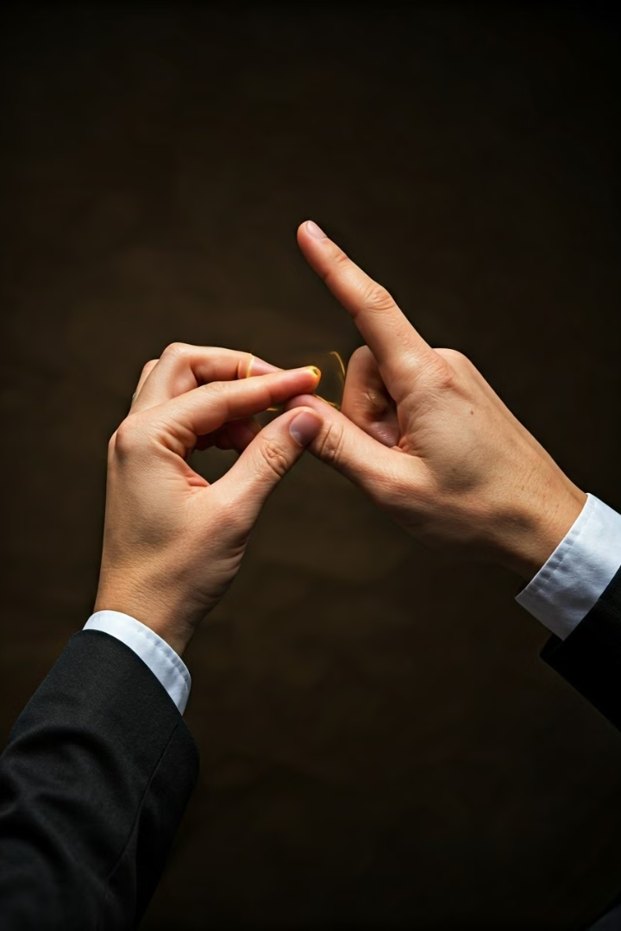
Gesture Recognition Model
1
Objective
Enable seamless gesture-based communication for users.
2
Technology
CNN for classification, OpenCV for real-time processing.
3
Challenges
Optimizing for varied lighting and background conditions.

Slide 6
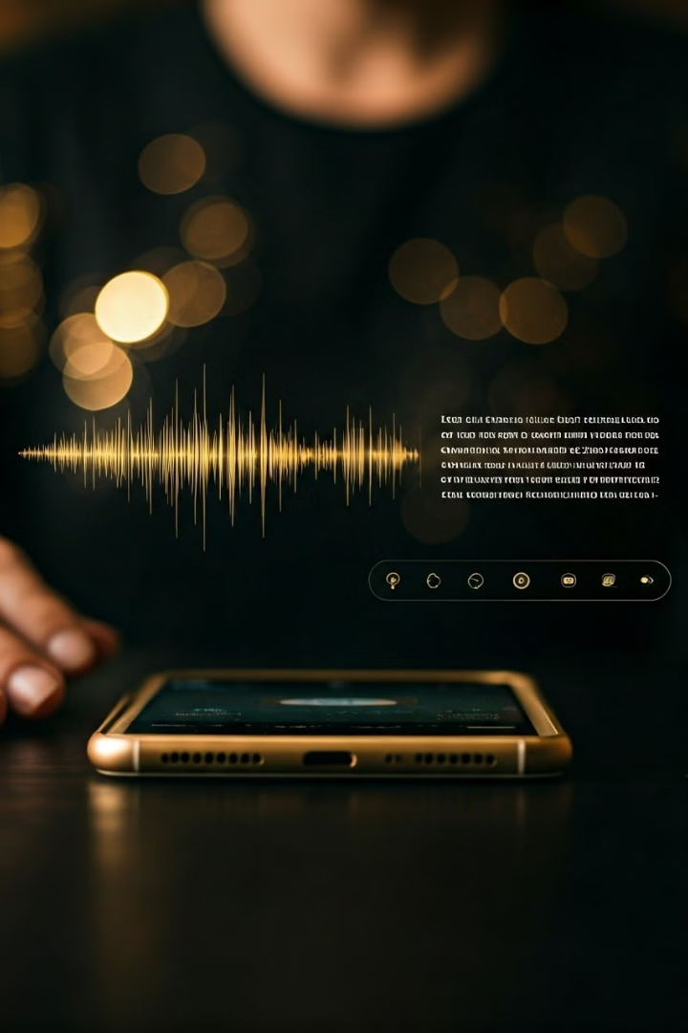
Voice Recognition Model
1
Objective
Accurately process and respond to diverse voice commands.
2
Technology
NLP with SpeechRecognition and NLTK libraries.
3
Challenges
Noise reduction and maintaining performance in dynamic environments.

Slide 7
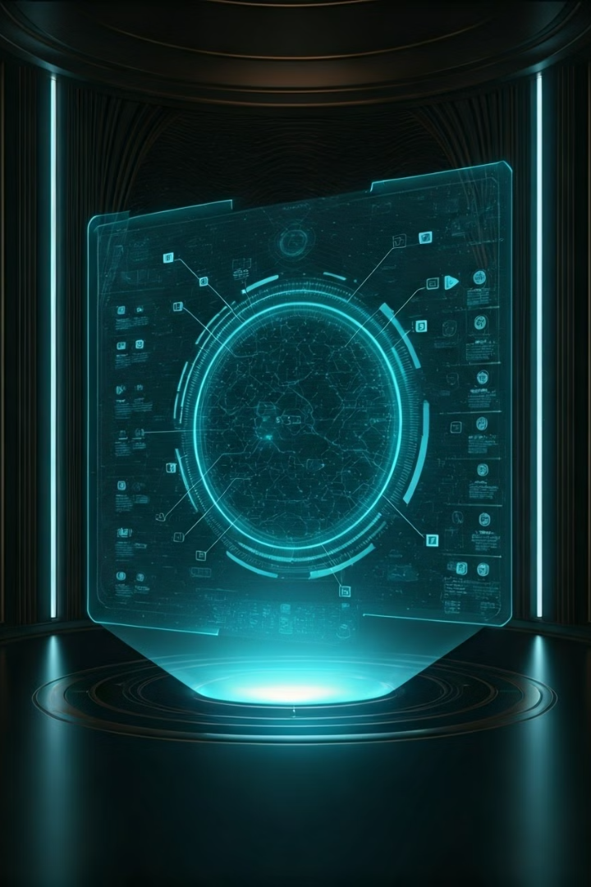
Object Detection Model (In Progress)
Objective
Identify and process objects in user's surroundings.
Status
Data collection and initial model setup underway.
Technology
CNN using YOLO or Faster R-CNN for classification.
Next Steps
Train and fine-tune model with diverse datasets.

Slide 8

Technology Stack
Deep Learning
CNNs for all models
Computer Vision
Real-time gesture and object detection
NLP
Voice command interpretation
Backend
Flask integration
Libraries
TensorFlow, PyTorch, OpenCV, SpeechRecognition

Slide 9
Current Progress and Challenges
Completed
In Progress
Challenges
Gesture Recognition Model
Object Detection Model
Real-time performance
Voice Recognition Model
Seamless integration
Handling edge cases

Slide 10
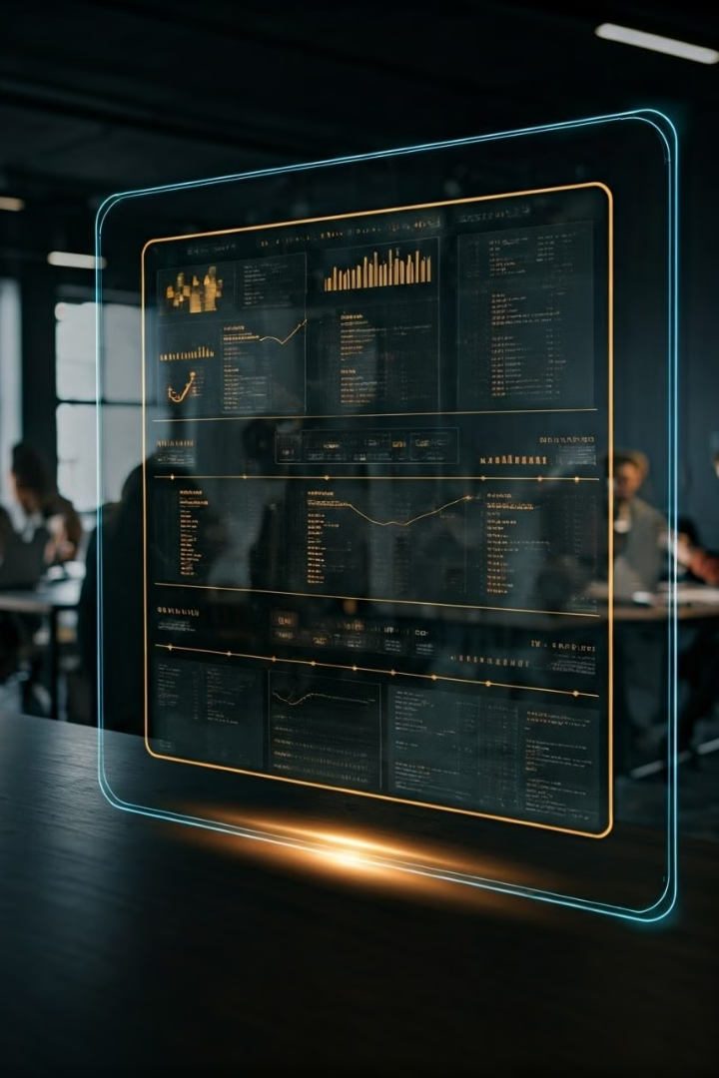
Next Steps & Timeline
1
Object Detection
Complete and fine-tune the model.
2
Integration
Combine all models into cohesive Flask-based system.
3
Testing
Refine for real-world applications and edge cases.

Slide 11
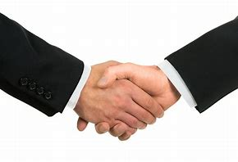
Thank You

